Slide 1

Title slide + image
Bloom Filter-Based MPSI
Weekly Progress Meeting 11 Dec 2025
Andra Alăzăroaie
Supervisor: Lilika Markatou
Daily Supervisor: Tjitske Koster

Slide 2
Bibliography
[1] Jelle Vos, Jorrit van Assen, Tjitske Koster, Evangelia Anna Markatou, and Zekeriya Erkin. On the insecurity of bloom filter-based private set intersections. Cryptology ePrint Archive, 2024.
[2] Aslı Bay, Zekeriya Erkin, Jaap-Henk Hoepman, Simona Samardjiska, and Jelle Vos. Practical multi-party private set intersection protocols. IEEE Transactions on Information Forensics and Security, 17:1–15, 2021.
[3] Ou Ruan, Changwang Yan, Jing Zhou, and Chaohao Ai. A practical multiparty private set intersection protocol based on bloom filters for unbalanced scenarios. Applied Sciences, 13(24):13215, 2023.
[4] Ou Ruan and Chaohao Ai. An efficient multi-party private set intersection protocols based on bloom filter. In Second International Conference on Algorithms, Microchips, and Network Applications (AMNA 2023), volume 12635, pages 282–287. SPIE, 2023.
[5] Jelle Vos, MauroConti, and Zekeriya Erkin. Fast multi-party private set operations in the star topology from secure ands and ors. Cryptology ePrint Archive, 2022.
Notes:
[5] Jelle Vos, MauroConti, and Zekeriya Erkin. Fast multi-party private set operations in the star topology from secure ands and ors. Cryptology ePrint Archive, 2022.

Slide 3
Progress
From the plan last week:
Continue working on the code for [4].
  When I get to benchmarking, I want to also research better ways of measuring time in C++ and of calculating communication costs (take inspiration from the APSI paper). Next week
Read [5] and inspect its implementation.
Ongoing study: the attack and proofs in [1].

Slide 4
Progress
Read [5] and went through its code.
Finished the implementation of [4], tested it.
  Still have to do benchmarking

Slide 5
Progress
Description of the protocol of [4]:
  Clients create and encrypt their BFs using ElGamal (for the “0” bins, they encrypt a random group element)
  Server combines them (multiplies them), obtains the combined encrypted BF
  Clients compute decryption shares using the combined encrypted BF and their secret keys
  Server combines them (multiplies them), obtains the combined BF
  Server checks its own elements against the combined BF and thus computes the intersection

Slide 6
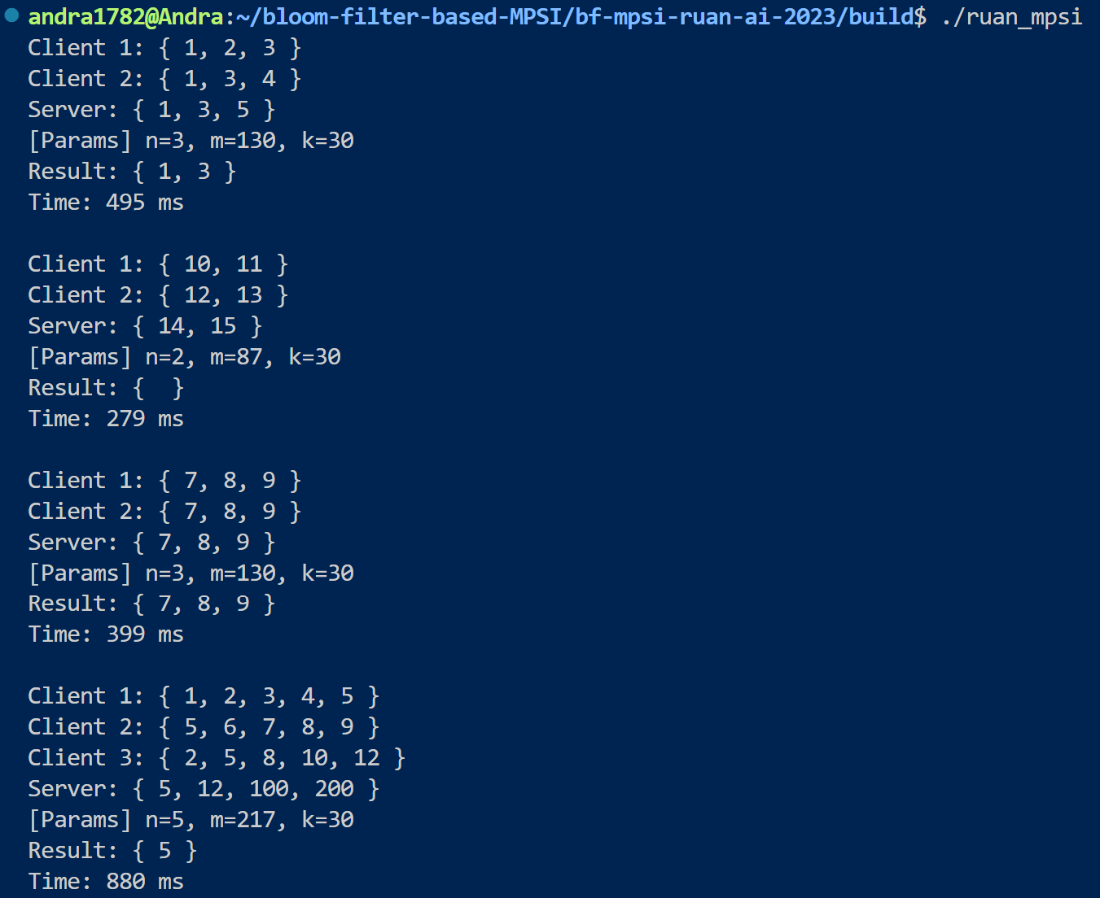
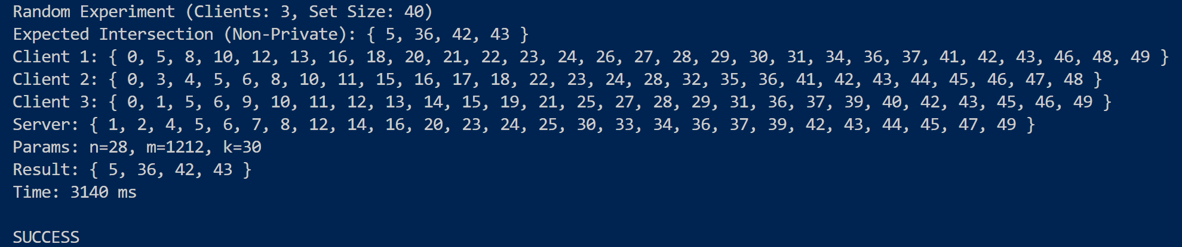
Progress
Tests for [4]:

Slide 7
Challenges
Finishing the implementation details

Slide 8
Next Week
Implement benchmarking for [4].
Adapt the implementation to [3]?
Ongoing study: the attack and proofs in [1].
Revision of [2], [3], [5].

Slide 9
Afsluiter
Thank you!

